Slide 1
Workshop on Population and Speciation Genomics, Cesky Krumlov SNP and genotype calling (and more) – Day 3
Matteo Fumagalli
January 27th 2016

Slide 2
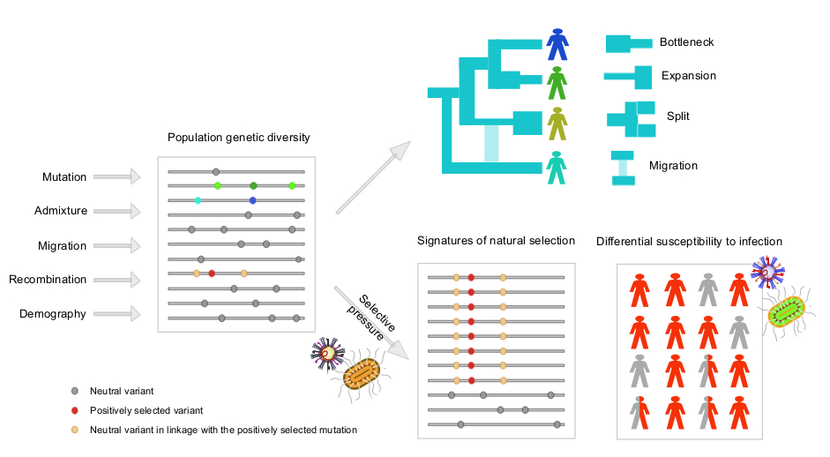
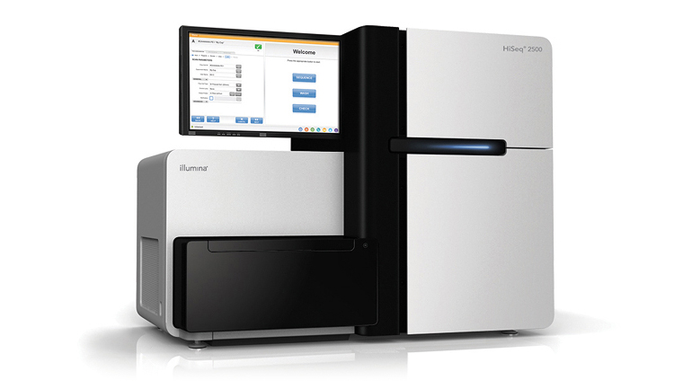
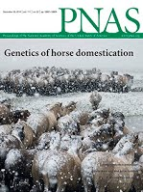

Population genonics

Slide 3
What I’ll be talking about today
Intro and basic filtering of NGS data
Genotype calling
SNP calling and estimation of allele frequencies
Advanced methods for population genetic analyses for low-depth data
Paper discussion
Intro to practical exercises
Bioinformatics

Slide 4
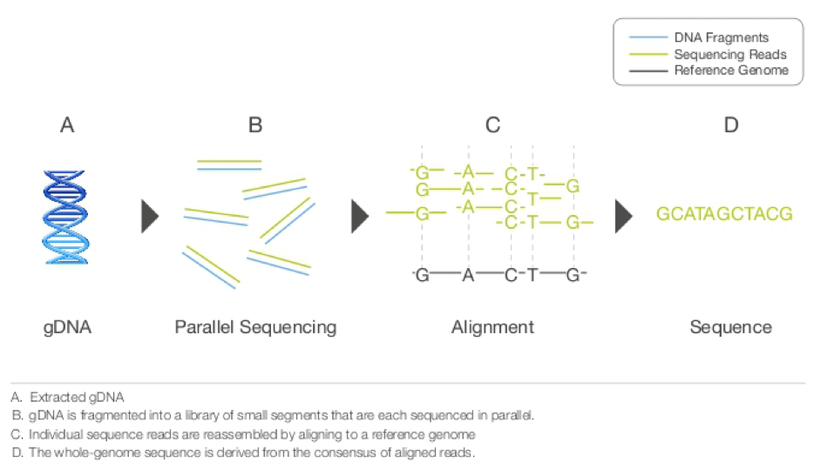
Next-Generation Sequencing

Slide 5
Different platforms
Technology | Read length | Gbp / day | Cost $/Mb
Sanger | 1 kb | 0.006 | ~ 500
454 | 450 bp | 0.5 | ~ 20
Solexa / Illumina | 2 x 100 bp | 25 | ~ 0.5
SOLiD | 2 x 50 bp | 10 | ~ 0.5
…
PacBio | 10 kb

Slide 6
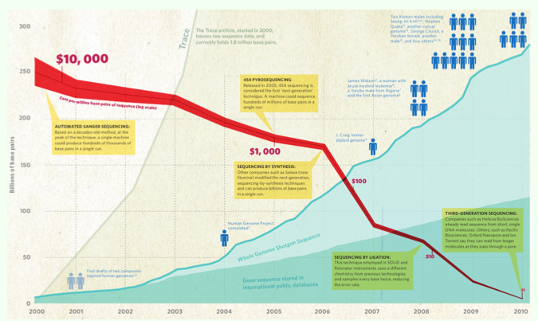
Sequencing cost

Slide 7
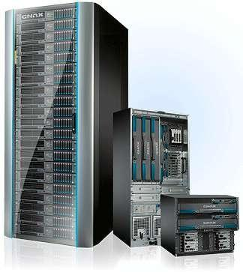
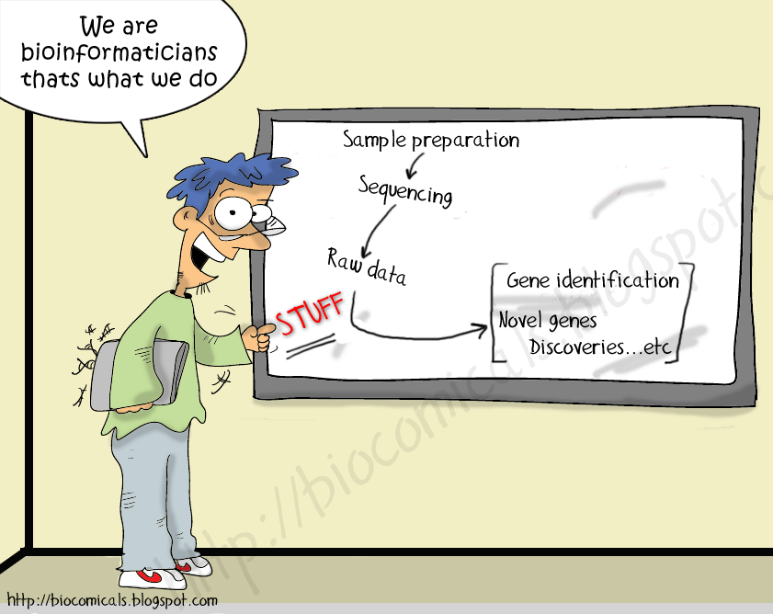
New costs

Slide 8
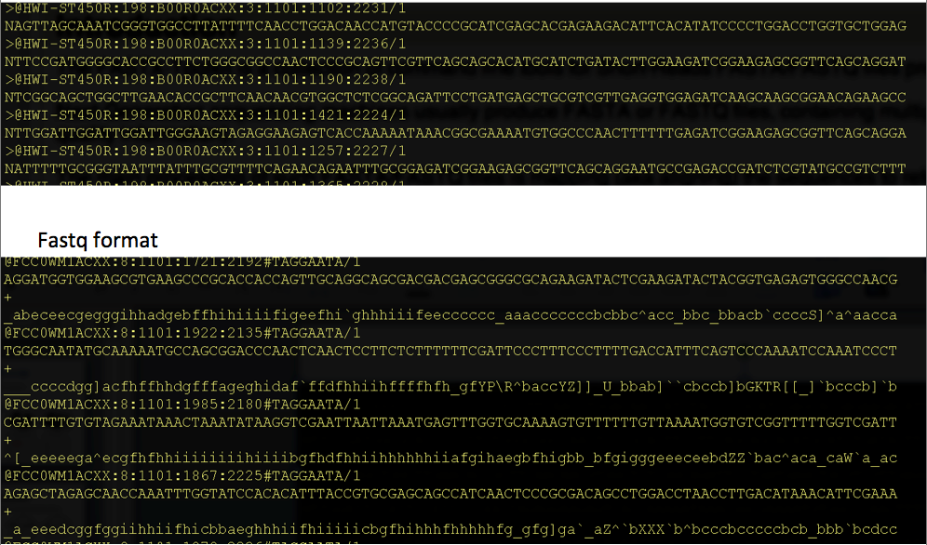
New data and new files

Slide 9
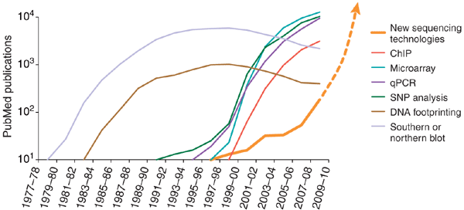
Usage of NGS
Avak Kahvejian, John Quackenbush & John F Thompson
Nature Biotechnology 26, 1125 - 1133 (2008)

Slide 10
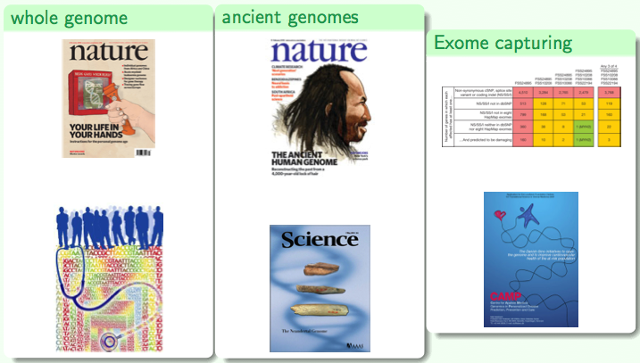
Applications

Slide 11
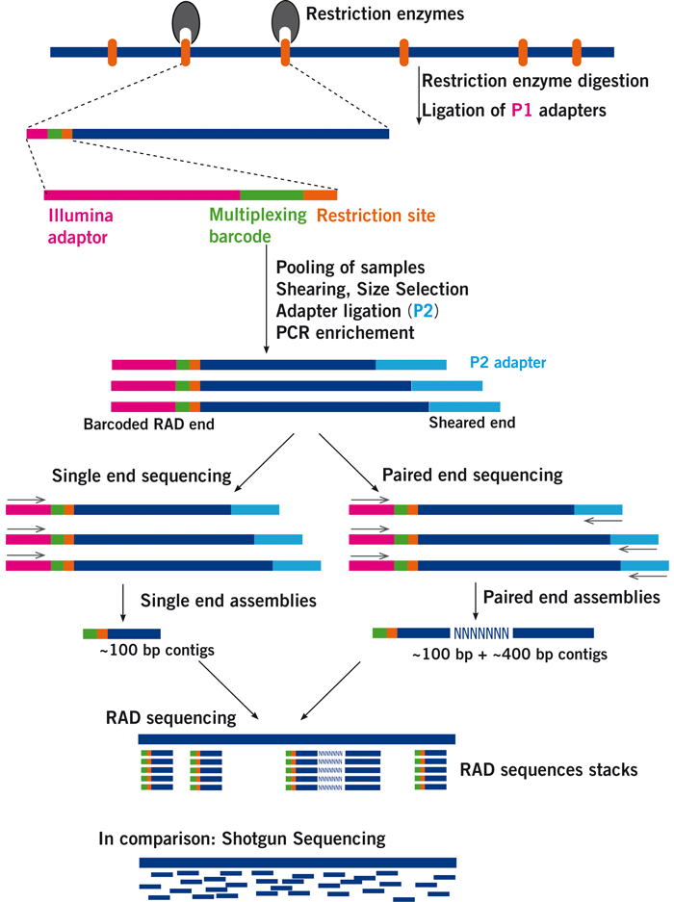
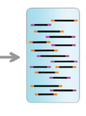
RAD-sequencing
Pooled
sequencing
…
http://www.floragenex.com/

Slide 12
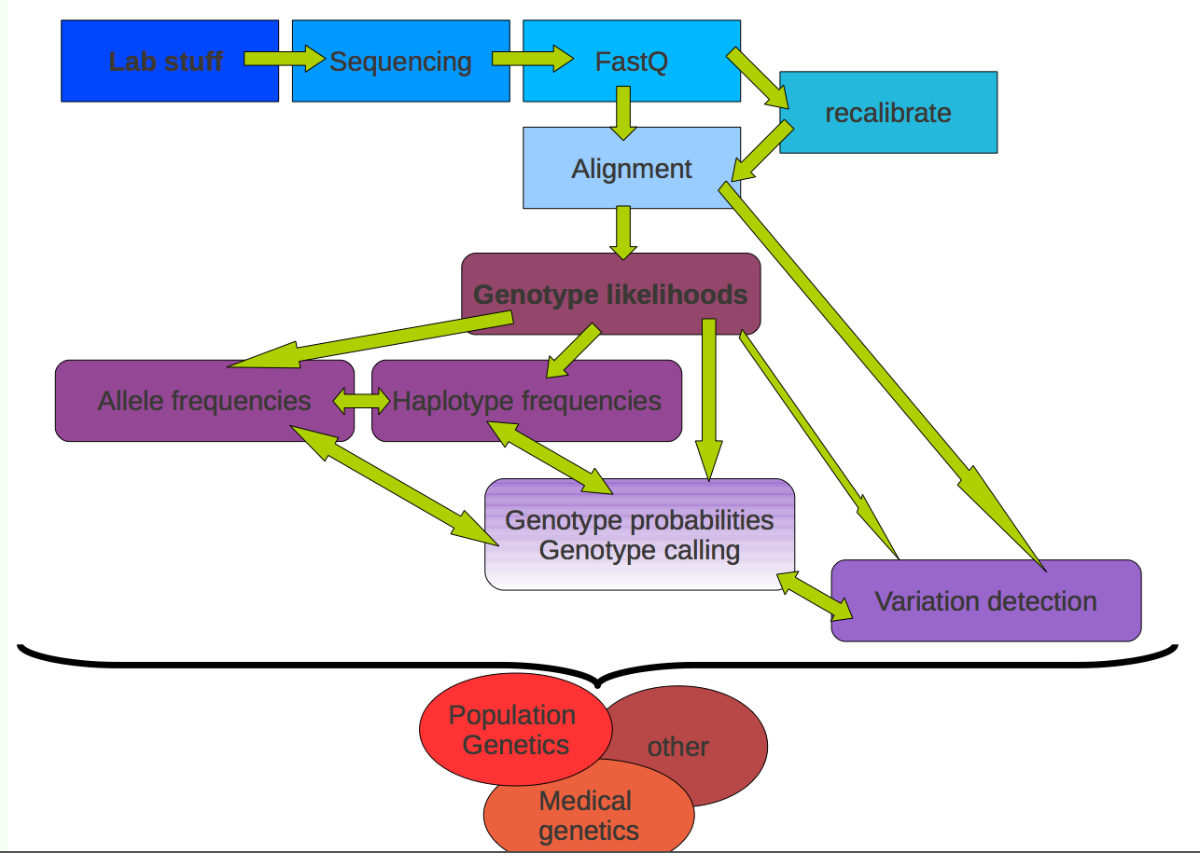
Workflow

Slide 13
Workflow
Low-level data:
Samples preparation + sequencing
Call bases and quality scores
Genotype data:
Call genotypes
Estimate allele/haplotype frequencies
SNPs detection
Analysis:
Population genetics analysis
Association studies

Slide 14
Workflow
Low-level data:
Samples preparation + sequencing
Call bases and quality scores
Genotype data:
Call genotypes
Estimate allele/haplotype frequencies
SNPs detection
Analysis:
Population genetics analysis
Association studies

Slide 15
Workflow
Low-level data:
Samples preparation + sequencing
Call bases and quality scores
Genotype data:
Call genotypes
Estimate allele/haplotype frequencies
SNPs detection
Analysis:
Population genetics analysis
Association studies

Slide 16
Workflow
Low-level data:
Samples preparation + sequencing
Call bases and quality scores
Genotype data:
Call genotypes
Estimate allele/haplotype frequencies
SNPs detection
Analysis:
Population genetics analysis
Association studies

Slide 17
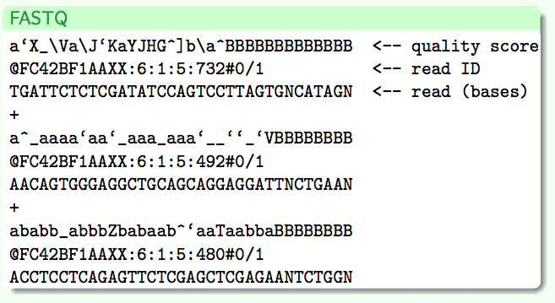
Low-level data

Slide 18
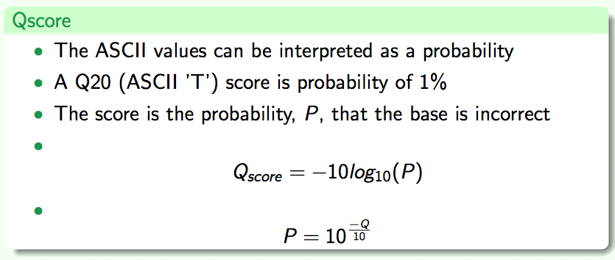
Quality scores
!"#$%&'()*+,-./0123456789:;⬄@ABCDEFGHIJKLMNOPQRSTUVWXYZ[\]^_`abcdefghijklmnopqrstuvwxyz{|}~

Slide 19
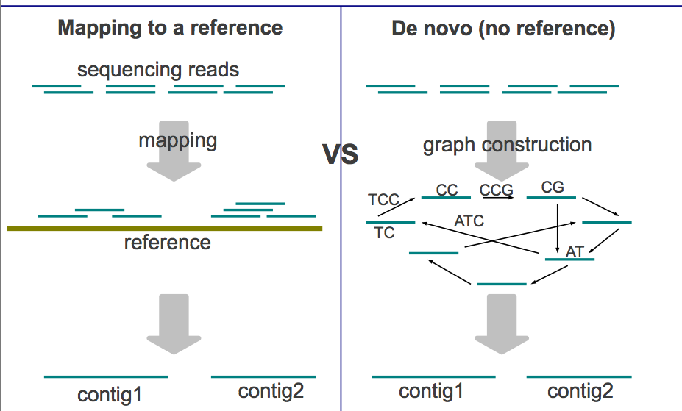
Assembly

Slide 20
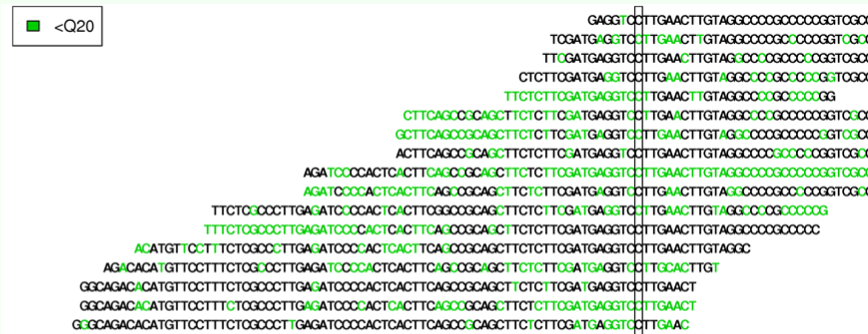
Mapped reads
Depth: number of reads mapped to a position
Counts: number of different alleles mapped to a position
Coverage: fraction of the genome with data

Slide 21
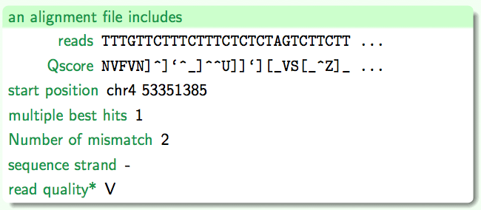
Alignment file

Slide 22
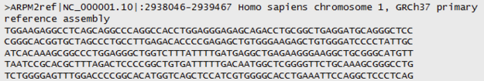
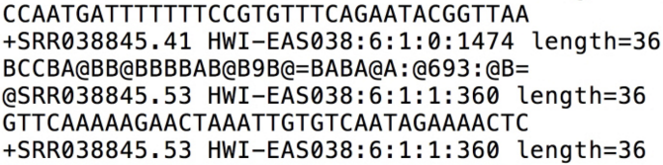
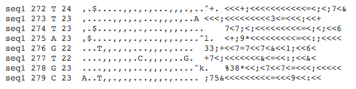
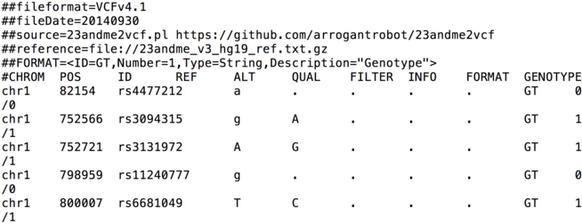
From genome to variants
Genome (FASTA)
Reads (FASTQ) Mapped Reads (mpileup, BAM)
Variants (VCF)

Slide 23
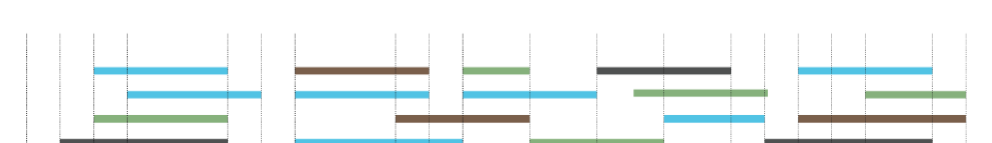
Challenges

Slide 24
Challenges
Variable and low depth
High sequencing and mapping errors

Slide 25
Challenges
Variable and low depth
High sequencing and mapping errors
Quality control filters

Slide 26
Data filtering
Variable and low depth

Slide 27
Data filtering
Variable and low depth
Minimum depth
Maximum depth
Even depth across samples
…

Slide 28
Data filtering
Sequencing and mapping errors

Slide 29
Challenges
Correct (?)
Strand bias
Allelic imbalance
A
A
A
A
A
G
A
G
G
A
A
A
A
G
A
G
A
A
G
G
A
G
A
A
G
G
A

Slide 30
Data filtering
Sequencing and mapping errors
Minimum base and mapping quality
Base quality bias
Deviation from Hardy-Weinberg Equilibrium (HWE)
…

Slide 31
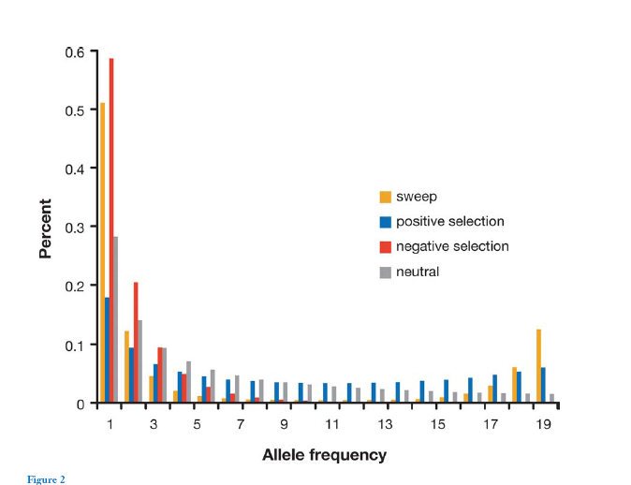
Site Frequency Spectrum (SFS)

Slide 32
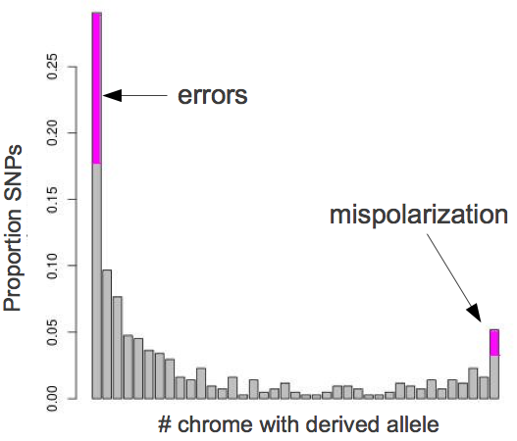
Effect of errors on the SFS
?
?

Slide 33
Effect of errors on the SFS
Sequencing errors
?
?

Slide 34
Effect of errors on the SFS
Remove low quality/depth sites.
Stricter SNP calling.
Remove aberrant individuals
Sequencing errors
?

Slide 35
Effect of errors on the SFS
Remove low quality/depth sites.
Stricter SNP calling.
Remove aberrant individuals
Sequencing errors
Mispolarization

Slide 36
Effect of errors on the SFS
Remove low quality/depth sites.
Stricter SNP calling.
Remove aberrant individuals
Sequencing errors
Check your outgroup.
Use folded data.
Mispolarization

Slide 37
Filtering pipeline
Dependency on your data and goals
Check intermediate files and Site Frequency Spectrum
Tune your parameters by iterating multiple times if necessary

Slide 38
Workflow
Low-level data:
Samples preparation + sequencing
Call bases and quality scores
Genotype data:
Call genotypes
Estimate allele/haplotype frequencies
SNPs detection
Analysis:
Population genetics analysis
Association studies

Slide 39
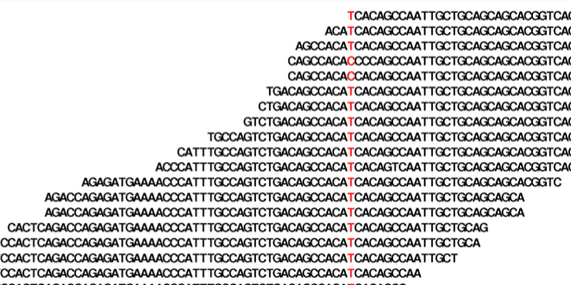
Genotypes calling
Sanger: both alleles are amplified and sequenced at the same time
NGS: each allele is sequenced separately and sampled with replacement

Slide 40
Likelihood
P(Data | Parameter = Value)
Maximum Likelihood Estimate (MLE):
from a set of observation, identify the value for the parameter (to be estimated) that maximize the likelihood of observing the data.
The integral of the likelihood function is not (always) 1.

Slide 41
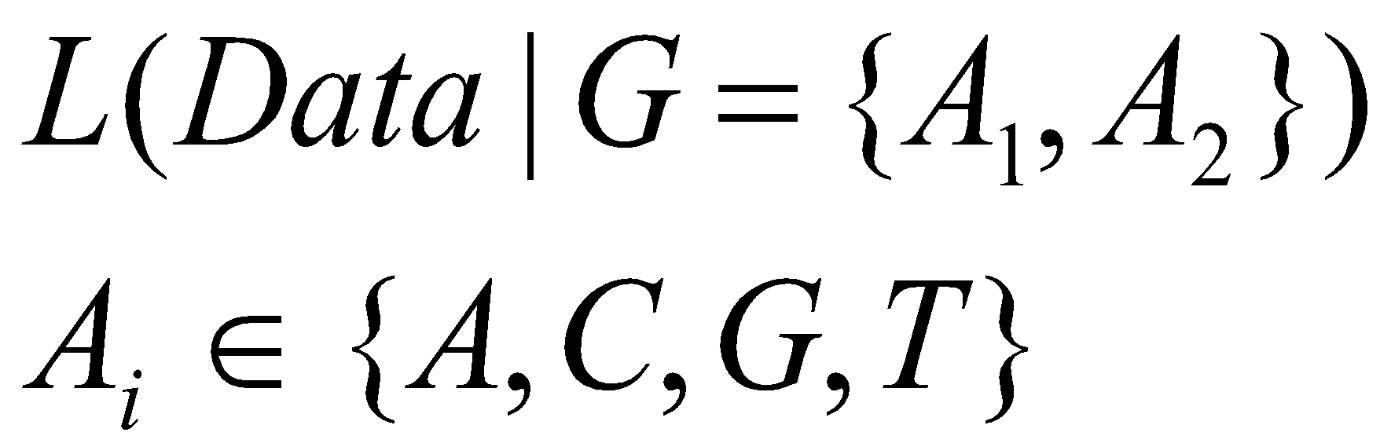
Genotype likelihoods
How many genotype likelihoods do we have for each individual at each site?

Slide 42
Genotype likelihoods
How many genotype likelihoods do we have for each individual at each site?
3 if both alleles are known
10 if not

Slide 43
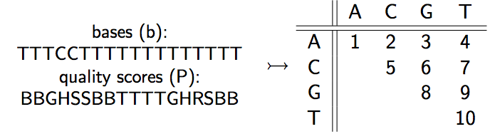
Genotype likelihoods
Summarize the reads data in 10 genotype likelihoods:

Slide 44
Genotype likelihoods
SAMtools (H Li et al., 2008): quality scores, quality dependency
soapSNP (R Li et al., 2009): quality scores, quality dependency
GATK (McKenna et al, 2010): quality scores
Kim et al. (2011): type specific errors
…

Slide 45
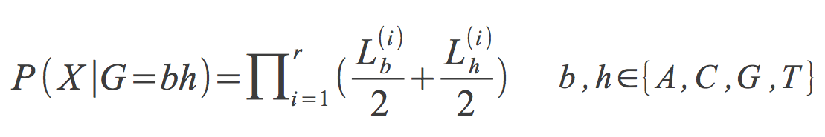
Calculating genotype likelihoods

Slide 46
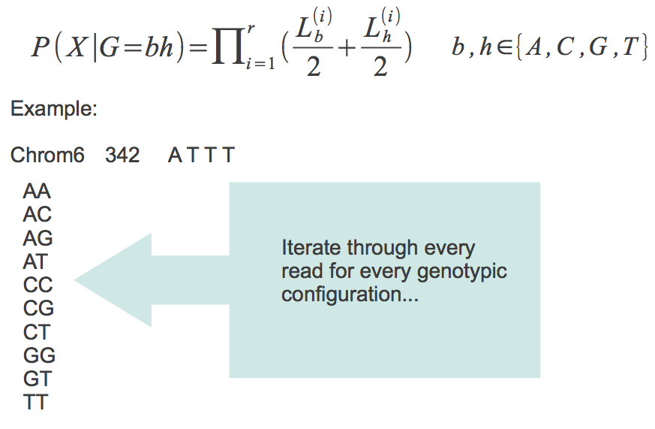
Calculating genotype likelihoods
A
T
T
T
Individual 1
T
T
Individual 2
A
A
T
T
Individual 3

Slide 47
Calculating genotype likelihoods

Slide 48
Calculating genotype likelihoods

Slide 49
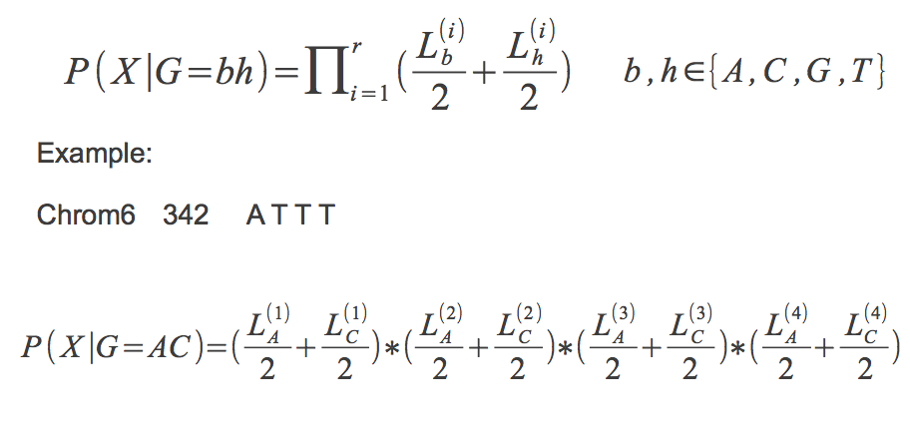
Calculating genotype likelihoods

Slide 50
Calculating genotype likelihoods

Slide 51
Calculating genotype likelihoods

Slide 52
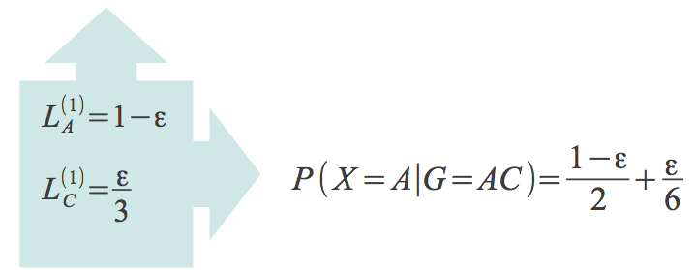
Calculating genotype likelihoods

Slide 53
Calculating genotype likelihoods

Slide 54
Calculating genotype likelihoods

Slide 55
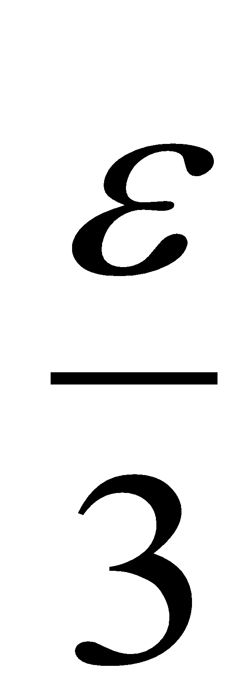
Calculating genotype likelihoods

Slide 56
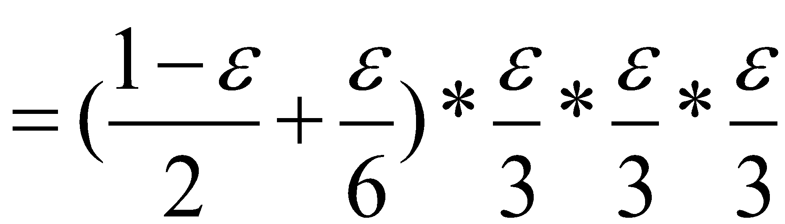
Calculating genotype likelihoods

Slide 57
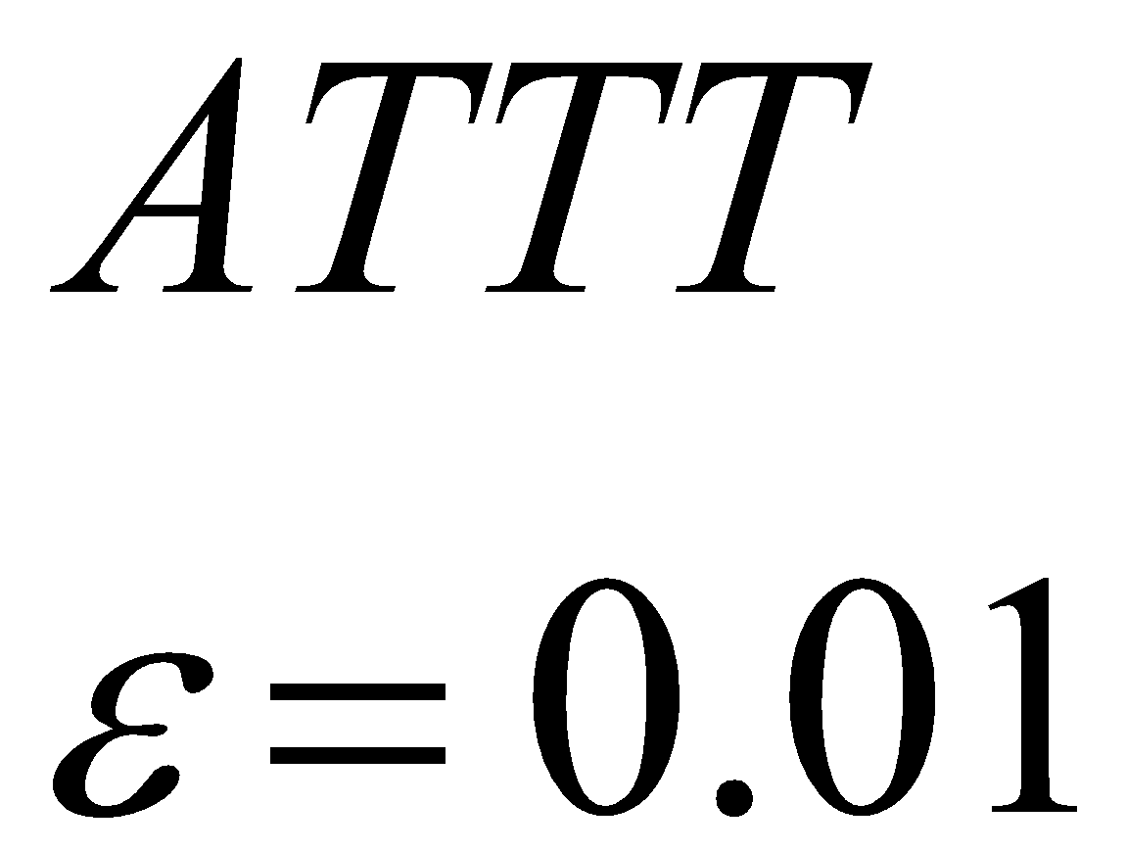
Genotype likelihoods
Genotype | Likelihood (log10)
AA | -7.44
AC | -7.74
AG | -7.74
AT | -1.22
CC | -9.91
CG | -9.91
CT | -3.38
GG | -9.91
GT | -3.38
TT | -2.49

Slide 58
Genotype calling
Genotype | Likelihood (log10)
AA | -7.44
AC | -7.74
AG | -7.74
AT | -1.22
CC | -9.91
CG | -9.91
CT | -3.38
GG | -9.91
GT | -3.38
TT | -2.49
What is the genotype here?

Slide 59
Genotype calling
Genotype | Likelihood (log10)
AA | -7.44
AC | -7.74
AG | -7.74
AT | -1.22
CC | -9.91
CG | -9.91
CT | -3.38
GG | -9.91
GT | -3.38
TT | -2.49
Simple genotype caller:
Maximum Likelihood
Choose the genotype with the largest likelihood
AT

Slide 60
Genotype calling
Simple genotype caller:
Maximum Likelihood
But only call the genotype if the largest likelihood is much better than the second best
Genotype | Likelihood (log10)
AA | -7.44
AC | -7.74
AG | -7.74
AT | -1.22
CC | -9.91
CG | -9.91
CT | -3.38
GG | -9.91
GT | -3.38
TT | -2.49

Slide 61
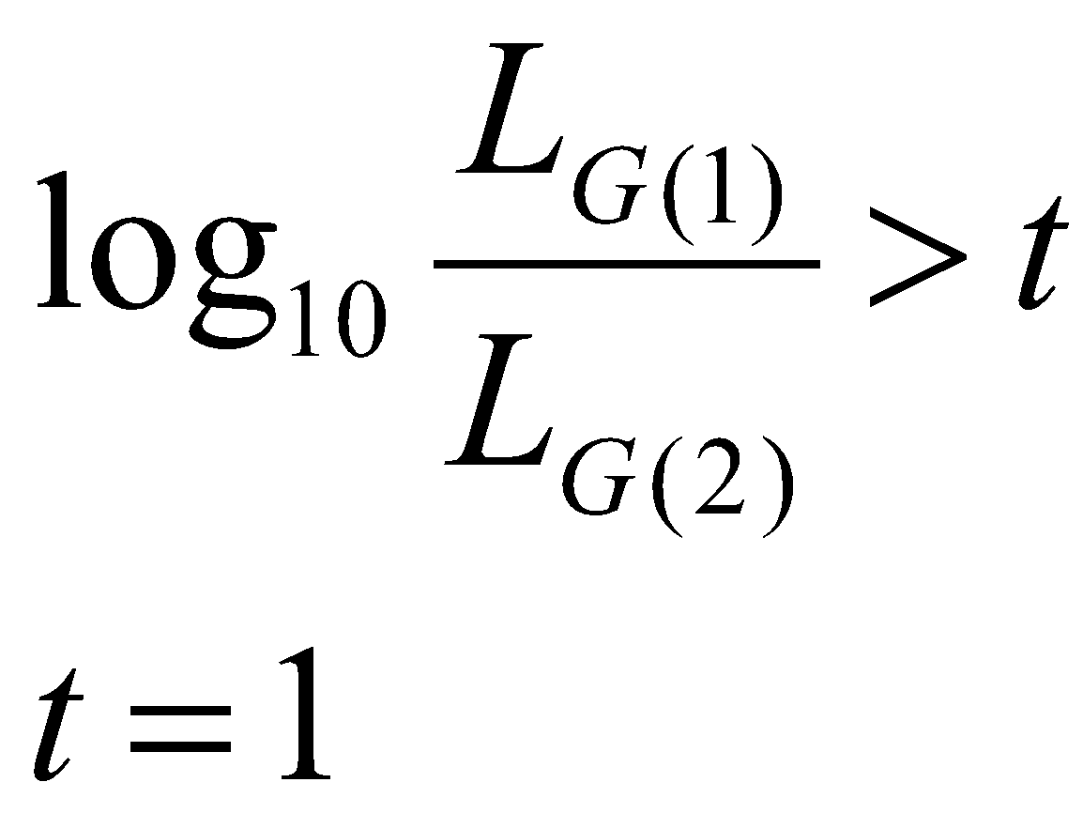
Genotype calling
Likelihood Ratio:
The most likely genotype is at least 10 times more likely than the second most likely one
(in our example t=1.27)

Slide 62
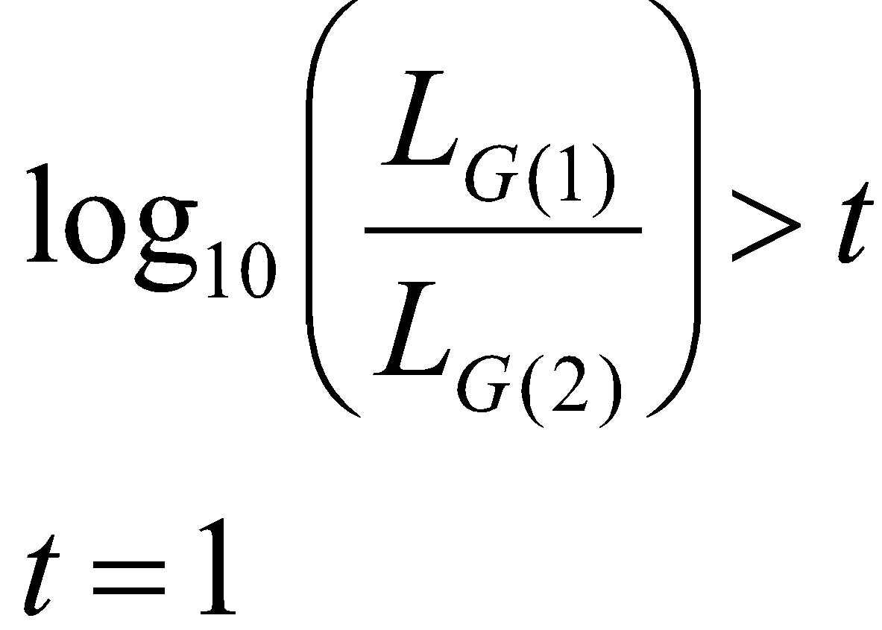
Genotype calling
Likelihood Ratio:
The most likely genotype is at least 10 times more likely than the second most likely one
Higher confidence of called genotypes
More missing data

Slide 63
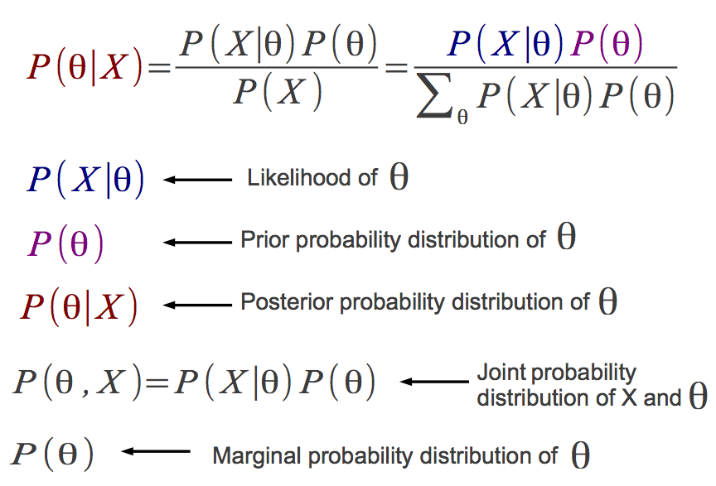
Bayesian inference

Slide 64
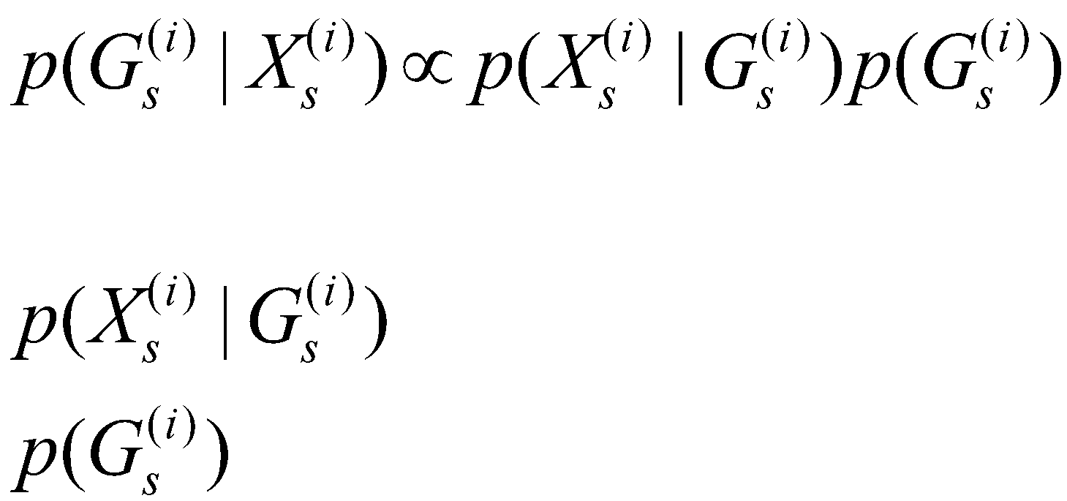
Genotype posterior probabilities
Genotype likelihood
Prior

Slide 65
Genotype posterior probabilities
Genotype | Likelihood (log10) | Prior | Posterior probability
AA | -7.44 | 1/10 | ~ 0
AC | -7.74 | 1/10 | ~ 0
AG | -7.74 | 1/10 | ~ 0
AT | -1.22 | 1/10 | 0.94
CC | -9.91 | 1/10 | ~ 0
CG | -9.91 | 1/10 | ~ 0
CT | -3.38 | 1/10 | 0.006
GG | -9.91 | 1/10 | ~ 0
GT | -3.38 | 1/10 | 0.006
TT | -2.49 | 1/10 | 0.05
Simple genotype caller:
Bayesian
AT

Slide 66
Genotype posterior probabilities
Genotype | Likelihood (log10) | Prior | Posterior probability
AA | -7.44 | 1/10 | ~ 0
AC | -7.74 | 1/10 | ~ 0
AG | -7.74 | 1/10 | ~ 0
AT | -1.22 | 1/10 | 0.94
CC | -9.91 | 1/10 | ~ 0
CG | -9.91 | 1/10 | ~ 0
CT | -3.38 | 1/10 | 0.006
GG | -9.91 | 1/10 | ~ 0
GT | -3.38 | 1/10 | 0.006
TT | -2.49 | 1/10 | 0.05
Simple genotype caller:
Bayesian
But only call the genotype if the largest probability is above a threshold (e.g. > 0.95)

Slide 67
Genotype posterior probabilities
Simple genotype caller:
Bayesian
P(A) = 0.9 if A is the reference allele;
P(A) = 0.1 otherwise
Example: reference is T
P(TT) = P(A)²
Genotype | Likelihood (log10) | Prior | Posterior probability
AA | -7.44 | 0.01 | ~ 0
AC | -7.74 | 0.01 | ~ 0
AG | -7.74 | 0.01 | ~ 0
AT | -1.22 | 0.09 | 0.67
CC | -9.91 | 0.01 | ~ 0
CG | -9.91 | 0.01 | ~ 0
CT | -3.38 | 0.09 | 0.005
GG | -9.91 | 0.01 | ~ 0
GT | -3.38 | 0.09 | 0.0005
TT | -2.49 | 0.81 | 0.32
AT (?)

Slide 68
Genotype posterior probabilities
Better genotype caller:
Bayesian
P(A) = f
Where f (=0.75) is the allele frequency from a reference panel
Example: reference is T
P(TT) = …
P(AT) = …
P(AA) = …
Genotype | Likelihood (log10) | Prior | Posterior probability
AA | -7.44
AC | -7.74
AG | -7.74
AT | -1.22
CC | -9.91
CG | -9.91
CT | -3.38
GG | -9.91
GT | -3.38
TT | -2.49

Slide 69
Genotype posterior probabilities
Better genotype caller:
Bayesian
P(A) = f
Where f (=0.75) is the allele frequency from a reference panel
Example: reference is T
P(TT) = f²
P(AT) = …
P(AA) = …
Genotype | Likelihood (log10) | Prior | Posterior probability
AA | -7.44
AC | -7.74
AG | -7.74
AT | -1.22
CC | -9.91
CG | -9.91
CT | -3.38
GG | -9.91
GT | -3.38
TT | -2.49 | 0.56

Slide 70
Genotype posterior probabilities
Better genotype caller:
Bayesian
P(A) = f
Where f (=0.75) is the allele frequency from a reference panel
Example: reference is T
P(TT) = f²
P(AT) = 2f(1-f)
P(AA) = …
Genotype | Likelihood (log10) | Prior | Posterior probability
AA | -7.44
AC | -7.74
AG | -7.74
AT | -1.22 | 0.38
CC | -9.91
CG | -9.91
CT | -3.38
GG | -9.91
GT | -3.38
TT | -2.49 | 0.56

Slide 71
Genotype posterior probabilities
Better genotype caller:
Bayesian
P(A) = f
Where f is the allele frequency from a reference panel
Example: reference is T
P(TT) = f²
P(AT) = 2f(1-f)
P(AA) = (1-f)²
Assuming f=0.75 and only A and T alleles
Genotype | Likelihood (log10) | Prior | Posterior probability
AA | -7.44 | 0.06 | ~ 0
AC | -7.74 | 0 | 0
AG | -7.74 | 0 | 0
AT | -1.22 | 0.38 | 0.93
CC | -9.91 | 0 | 0
CG | -9.91 | 0 | 0
CT | -3.38 | 0 | 0
GG | -9.91 | 0 | 0
GT | -3.38 | 0 | 0
TT | -2.49 | 0.56 | 0.07

Slide 72
Genotype posterior probabilities
Genotype | Likelihood (log10) | Prior | Posterior probability
AA | -7.44 | 0.16 | ~ 0
AC | -7.74 | 0 | 0
AG | -7.74 | 0 | 0
AT | -1.22 | 0.48 | 0.96
CC | -9.91 | 0 | 0
CG | -9.91 | 0 | 0
CT | -3.38 | 0 | 0
GG | -9.91 | 0 | 0
GT | -3.38 | 0 | 0
TT | -2.49 | 0.36 | 0.38
Better genotype caller:
Empirical Bayesian
P(A) = f
Where f is the allele frequency estimated from the data itself
With f=0.6

Slide 73
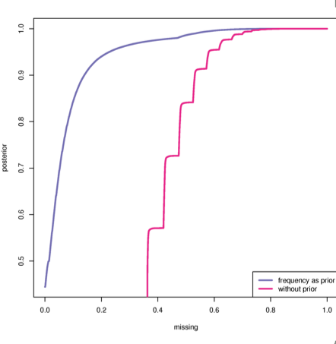
Missing data
Mean depth 8X
Prior | Threshold | Missing data rate
No | 99% | 70%
No | 99.9% | 80%
Allele frequency | 99% | 50%
Allele frequency | 99.9% | 65%
Threshold on genotype
Posterior probabilities
Missing data rate
Genotype calling should be performed including information from all samples.
Notes:
Why we don’t want to call genotypes!

Slide 74
Software
All these methods have been implemented in several software and utilities, such as:
SAMtools (http://samtools.sourceforge.net)
GATK (https://www.broadinstitute.org/gatk)
ANGSD (http://popgen.dk/ANGSD)
freebayes (https://github.com/ekg/freebayes)

Slide 75
Workflow
Low-level data:
Samples preparation + sequencing
Call bases and quality scores
Genotype data:
Call genotypes
Estimate allele frequencies
SNPs detection
Analysis:
Population genetics analysis
Association studies

Slide 76
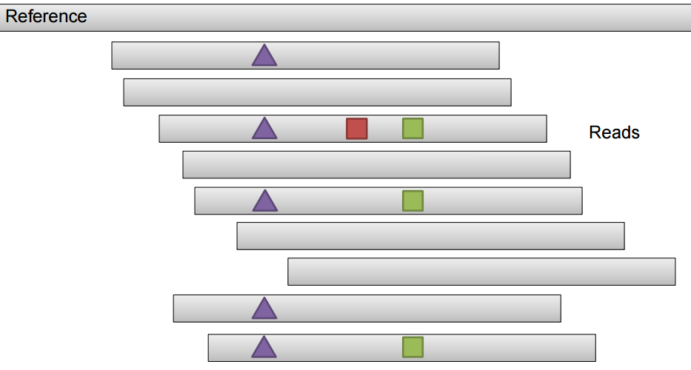
SNP calling procedures
Alignment-based caller
We completely rely on how reads have been mapped
Figure from Erik Garrison

Slide 77
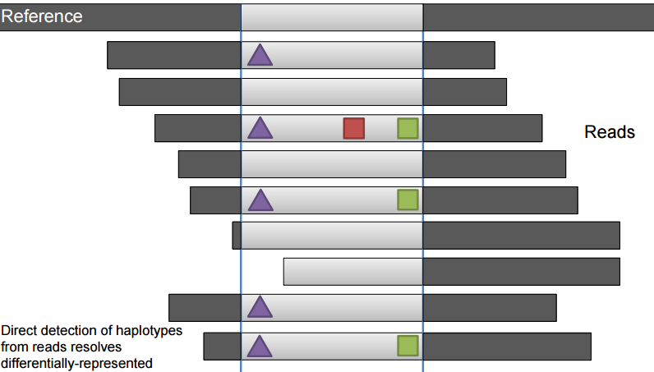
SNP calling procedures
Assembly-based caller (as in GATK)
Local re-alignment around putative variants; better resolution for INDELs detection.
Haplotype-based caller (as in freebayes)
Figure from Erik Garrison

Slide 78
Estimating allele frequencies
Individual | True genotype | Reads allele A | Reads allele G
1 | AA
2 | AA
3 | AG
4 | AG
5 | GG
6 | GG
Tot.
Assume only 2 allelic types
True allele frequency is 0.50

Slide 79
Estimating allele frequencies
Individual | True genotype | Reads allele A | Reads allele G
1 | AA | 7 | 0
2 | AA | 25 | 1
3 | AG | 5 | 3
4 | AG | 4 | 4
5 | GG | 0 | 2
6 | GG | 0 | 4
Tot. |  | 41 | 14
Assume only 2 allelic types
True allele frequency is 0.50

Slide 80
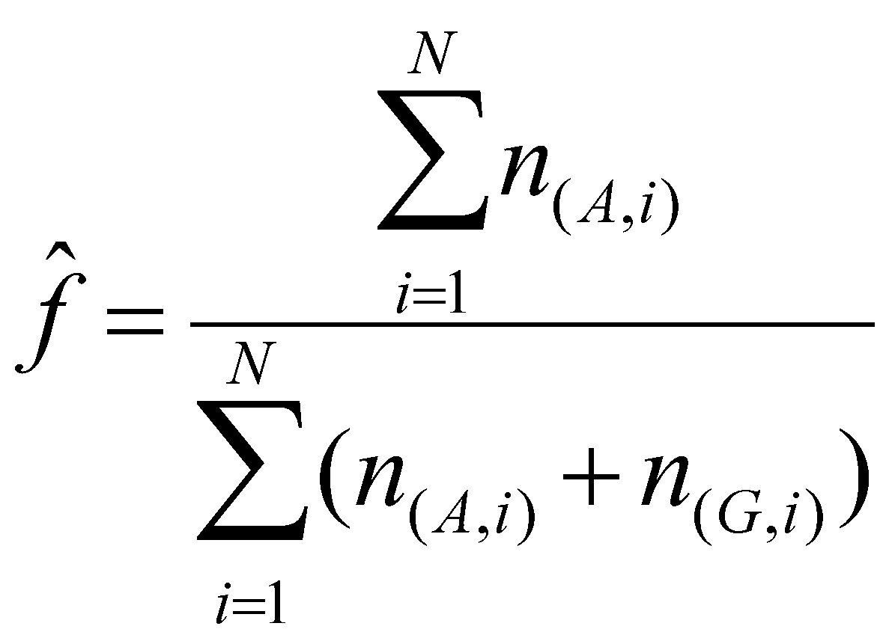
Estimating allele frequencies
Individual | True genotype | Reads allele A | Reads allele G
1 | AA | 7 | 0
2 | AA | 25 | 1
3 | AG | 5 | 3
4 | AG | 4 | 4
5 | GG | 0 | 2
6 | GG | 0 | 4
Tot. |  | 41 | 14
Simple allele frequency estimator:
from reads counts

Slide 81
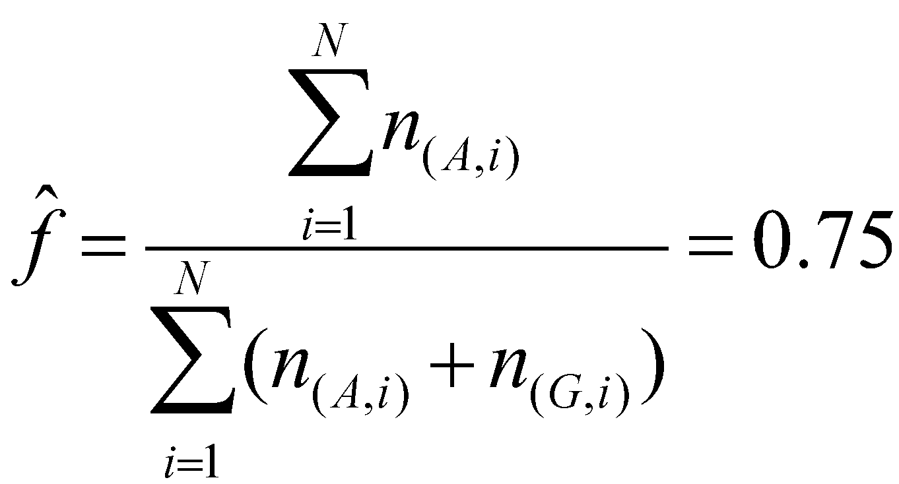
Estimating allele frequencies
Individual | True genotype | Reads allele A | Reads allele G
1 | AA | 7 | 0
2 | AA | 25 | 1
3 | AG | 5 | 3
4 | AG | 4 | 4
5 | GG | 0 | 2
6 | GG | 0 | 4
Tot. |  | 41 | 14
Simple allele frequency estimator:
from reads counts

Slide 82
Estimating allele frequencies
Individual | True genotype | Reads allele A | Reads allele G
1 | AA | 7 | 0
2 | AA | 25 | 1
3 | AG | 5 | 3
4 | AG | 4 | 4
5 | GG | 0 | 2
6 | GG | 0 | 4
Tot. |  | 41 | 14
Simple allele frequency estimator:
from reads counts

Slide 83
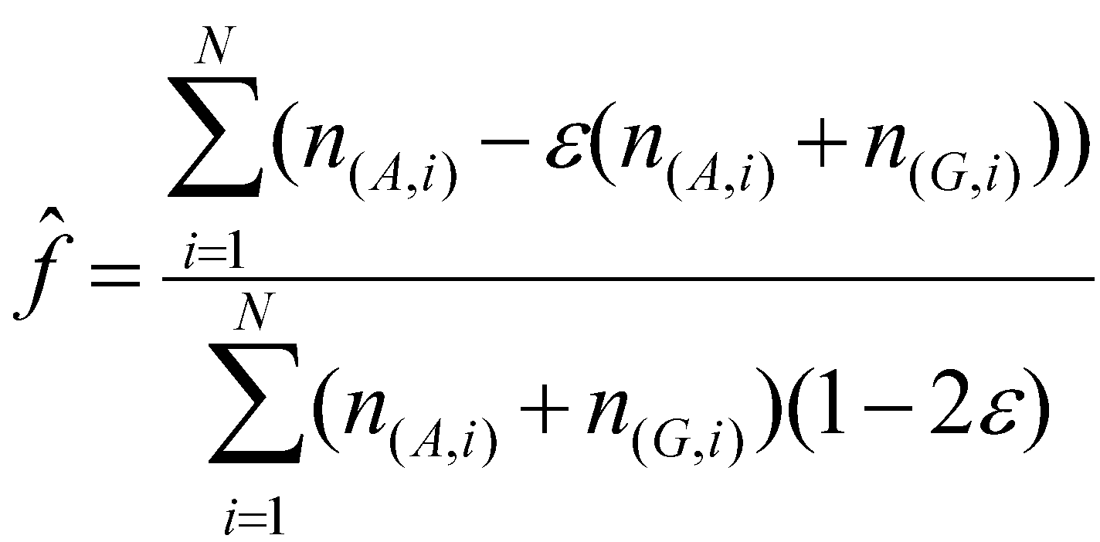
Estimating allele frequencies
Individual | True genotype | Reads allele A | Reads allele G
1 | AA | 7 | 0
2 | AA | 25 | 1
3 | AG | 5 | 3
4 | AG | 4 | 4
5 | GG | 0 | 2
6 | GG | 0 | 4
Tot. |  | 41 | 14
Simple allele frequency estimator:
from reads counts with error

Slide 84
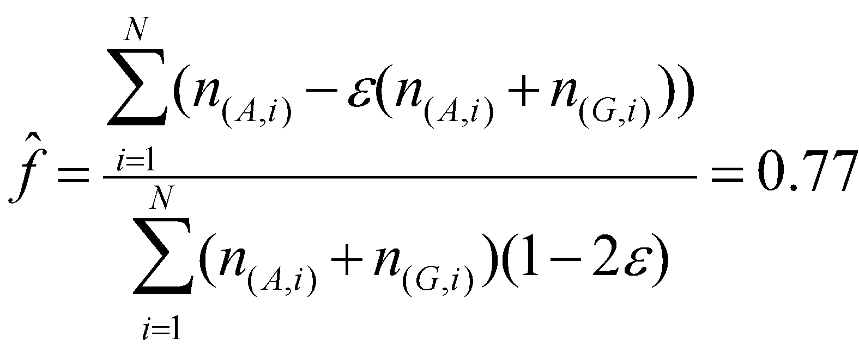
Estimating allele frequencies
Individual | True genotype | Reads allele A | Reads allele G
1 | AA | 7 | 0
2 | AA | 25 | 1
3 | AG | 5 | 3
4 | AG | 4 | 4
5 | GG | 0 | 2
6 | GG | 0 | 4
Tot. |  | 41 | 14
Simple allele frequency estimator:
from reads counts with error

Slide 85
Estimating allele frequencies
Individual | True genotype | Reads allele A | Reads allele G
1 | AA | 7 | 0
2 | AA | 25 | 1
3 | AG | 5 | 3
4 | AG | 4 | 4
5 | GG | 0 | 2
6 | GG | 0 | 4
Tot. |  | 41 | 14
Simple allele frequency estimator:
from reads counts with error

Slide 86
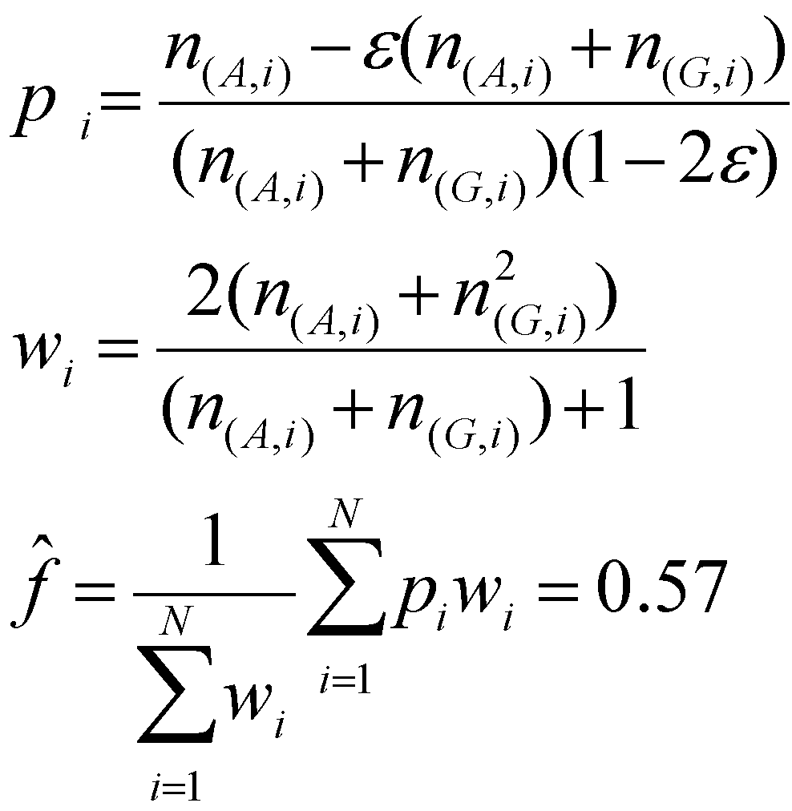
Estimating allele frequencies
Simple allele frequency estimator:
from reads counts with error and weights (Y Li et al. 2010)
Individual | True genotype | Reads allele A | Reads allele G
1 | AA | 7 | 0
2 | AA | 25 | 1
3 | AG | 5 | 3
4 | AG | 4 | 4
5 | GG | 0 | 2
6 | GG | 0 | 4
Tot. |  | 41 | 14
Notes:
Wi is scaled inverse of variance of pi

Slide 87
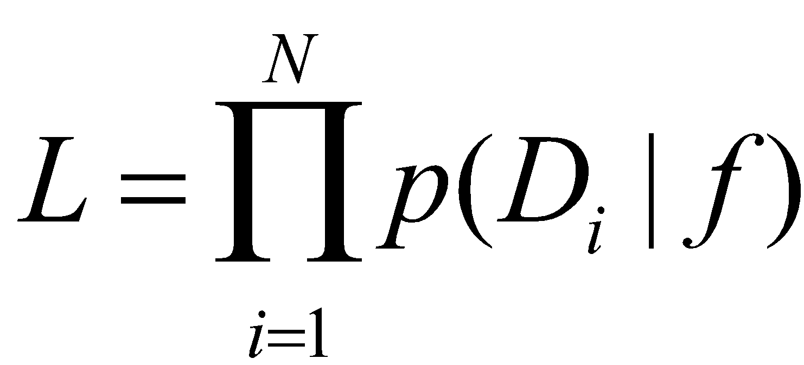
Estimating allele frequencies
Maximum Likelihood (ML) estimator (Kim et al. 2011)
Individual | True genotype | Reads allele A | Reads allele G
1 | AA | 7 | 0
2 | AA | 25 | 1
3 | AG | 5 | 3
4 | AG | 4 | 4
5 | GG | 0 | 2
6 | GG | 0 | 4
Tot. |  | 41 | 14
Notes:
Wi is scaled inverse of variance of pi

Slide 88
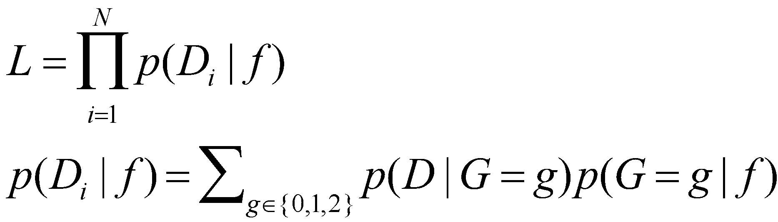
Estimating allele frequencies
Maximum Likelihood (ML) estimator (Kim et al. 2011)
Notes:
Wi is scaled inverse of variance of pi

Slide 89
Estimating allele frequencies
Maximum Likelihood (ML) estimator (Kim et al. 2011)
Notes:
Wi is scaled inverse of variance of pi

Slide 90
Estimating allele frequencies
Maximum Likelihood (ML) estimator (Kim et al. 2011)
Genotype likelihoods
Notes:
Wi is scaled inverse of variance of pi

Slide 91
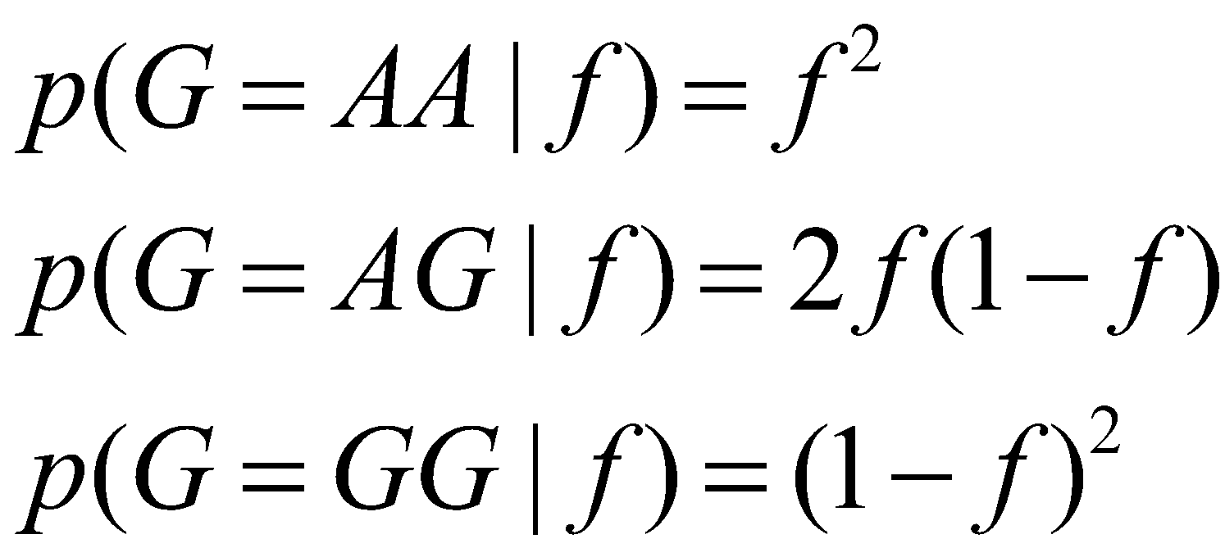
Estimating allele frequencies
Maximum Likelihood (ML) estimator (Kim et al. 2011)
Genotype likelihoods
If we assume HWE:
Notes:
Wi is scaled inverse of variance of pi

Slide 92

Estimating allele frequencies
Maximum Likelihood (ML) estimator (Kim et al. 2011)
Individual | True genotype | Reads allele A | Reads allele G
1 | AA | 7 | 0
2 | AA | 25 | 1
3 | AG | 5 | 3
4 | AG | 4 | 4
5 | GG | 0 | 2
6 | GG | 0 | 4
Tot. |  | 41 | 14
Notes:
Wi is scaled inverse of variance of pi

Slide 93
Workflow
Low-level data:
Samples preparation + sequencing
Call bases and quality scores
Genotype data:
Call genotypes
Estimate allele frequencies
SNPs detection
Analysis:
Population genetics analysis
Association studies

Slide 94
SNP calling
A lot of missing data if calling genotypes at low depth (heterozygotes can be lost!)
Rare variants are hard to detect
Trade-off between False Positives and False Negatives

Slide 95
SNP calling – effect of errors
Calling SNPs if 2 alternate alleles are observed (5X and 100 samples and error rate of 0.01):
False positive rate?

Slide 96
SNP calling – effect of errors
Calling SNPs if 2 alternate alleles are observed (5X and 100 samples and error rate of 0.01):
False positive rate? >99%

Slide 97
SNP calling – effect of errors
Calling SNPs if 2 alternate alleles are observed (5X and 100 samples and error rate of 0.01):
False positive rate? >99%
Heavy filtering of data (error rate of 0.001):
False positive rate?

Slide 98
SNP calling – effect of errors
Calling SNPs if 2 alternate alleles are observed (5X and 100 samples and error rate of 0.01):
False positive rate? >99%
Heavy filtering of data (error rate of 0.001):
False positive rate? 60%
Numbers from R. Nielsen

Slide 99
SNP calling
What is the most straightforward method to for SNP calling?

Slide 100
SNP calling
What is the most straightforward method to for SNP calling?
Assign as SNPs sites where at least one heterozygote has been called
…

Slide 101
SNP calling
What is the most straightforward method to for SNP calling?
Assign as SNPs sites where at least one heterozygote has been called
Assign as SNPs sites where the estimated allele frequency is above a certain threshold (e.g. ?)

Slide 102

SNP calling
MLE of allele frequency at each site:
Call a SNP if
Where t can be defined as the minimum sample allele frequency detectable (e.g. with 10 samples t can be set to 0.05)

Slide 103

SNP calling
Likelihood Ratio Test (LRT): test statistical hypotheses based on comparing the maximum likelihood under 2 different models.
T is chi-squared distributed with 1 degree of freedom -> assign a p-value

Slide 104
Workflow
Low-level data:
Samples preparation + sequencing
Call bases and quality scores
Genotype data:
Call genotypes
Estimate allele frequencies
SNPs detection
Population genetics analysis:
Site Frequency Spectrum
Summary statistics

Slide 105
Site Frequency Spectrum (SFS)

Slide 106

Effect of errors on SFS

Slide 107

Effect of errors on SFS
Using an ad hoc fixed cutoff for SNP calling…
can never produce unbiased estimates.

Slide 108

Effects of low-depth data
Nucleotide diversity scan using 1000 Genomes Project data (low-depth)
Cagliani et al. MBE. 2012

Slide 109
Effects of low-depth data
Nucleotide diversity scan using 1000 Genomes Project data (low-depth)
Highest peak based on Sanger sequencing!
Cagliani et al. MBE 2012

Slide 110

Effects of low-depth data
Sanger: detected a total of 24 variants
NGS: only 13
Most of them (n=8) have intermediate
frequency in all populations.
They are located within an AluSx element
in the 3'UTR.
A large portion of “inaccessible
Sites” in the low-depth1000 Genomes
data maps to repetitive sequences.
Cagliani et al. MBE 2012

Slide 111

Masked data
Highest peak recovered
Missing data
Unpredictable effects
Cagliani et al. MBE 2012

Slide 112

Maximum Likelihood Estimation (MLE) of the Site Frequency Spectrum
Parameterize the SFS, with k individuals
If unfolded, ? entries
If folded, ? entries

Slide 113
Maximum Likelihood Estimation (MLE) of the Site Frequency Spectrum
Parameterize the SFS, with k individuals
If unfolded, 2k+1 entries
If folded, 2k entries
p₀ | p₁ | p₂ | p₃ | … | p_{2k}
p₀ | p₁ | p₂ | … | p_{k}

Slide 114

ML estimation of the SFS
Summing across all unknown genotypes and multiplying the likelihood across sites.
Likelihood function:
Nielsen et al. 2012 PLoS One

Slide 115

ML estimation of the SFS
Simulated 30Mb
Error rate of 0.3%
Mean depth of 5X
TRUE
MLE
MLE, 6 regions combined

Slide 116

ML estimation of the SFS
Simulated 30Mb
Error rate of 0.3%
Mean depth of 5X
Mean depth of 1X:
TRUE
MLE
MLE, 6 regions combined
R. Nielsen

Slide 117
ML estimation of the SFS
Can be used for:
SNP calling
Genotype calling
Modeling uncertainty in population genetics analyses

Slide 118
Workflow
Low-level data:
Samples preparation + sequencing
Call bases and quality scores
Genotype data:
Call genotypes
Estimate allele frequencies
SNPs detection
Population genetics analysis:
Site Frequency Spectrum
Summary Statistics

Slide 119
Sample allele frequency posterior probabilities
S_{m}: sample allele frequency at site m
Likelihood
Prior
p(S_{m}=0) | p(S_{m}=1) | p(S_{m}=2) | p(S_{m}=3) | … | p(S_{m}=2k)

Slide 120
Sample allele frequency posterior probabilities
S_{m}: sample allele frequency at site m
Likelihood
Prior
Estimate of the overall SFS
p(S_{m}=0) | p(S_{m}=1) | p(S_{m}=2) | p(S_{m}=3) | … | p(S_{m}=2k)

Slide 121
Sample allele frequency posterior probabilities
p(S_{m}=0) | p(S_{m}=1) | p(S_{m}=2) | p(S_{m}=3) | … | p(S_{m}=2k)
Estimating allele frequency

Slide 122
Expected value
The expected value of a discrete random variable is the probability-weighted average of all possible values
Average value if you perform the same experiment many times
It is the value that one could expect on average

Slide 123

Sample allele frequency posterior probabilities
p(S_{m}=0) | p(S_{m}=1) | p(S_{m}=2) | p(S_{m}=3) | … | p(S_{m}=2k)
Estimating allele frequency

Slide 124
Sample allele frequency posterior probabilities
p(S_{m}=0) | p(S_{m}=1) | p(S_{m}=2) | p(S_{m}=3) | … | p(S_{m}=2k)
Estimating allele frequency
Used as prior for genotype calling

Slide 125

Sample allele frequency posterior probabilities
p(S_{m}=0) | p(S_{m}=1) | p(S_{m}=2) | p(S_{m}=3) | … | p(S_{m}=2k)
SNP calling
with t being 0.05, 0.01., 0.001 and so on.

Slide 126

Sample allele frequency posterior probabilities
p(S_{m}=0) | p(S_{m}=1) | p(S_{m}=2) | p(S_{m}=3) | … | p(S_{m}=2k)
SNP calling
with t being 0.05, 0.01., 0.001 and so on.

Slide 127
Nr of segregating sites
Site 1
Site 2
Site 3
…
Site M
p(S_{m}=0) | p(S_{m}=1) | p(S_{m}=2) | p(S_{m}=3) | … | p(S_{m}=2k)
p(S_{m}=0) | p(S_{m}=1) | p(S_{m}=2) | p(S_{m}=3) | … | p(S_{m}=2k)
p(S_{m}=0) | p(S_{m}=1) | p(S_{m}=2) | p(S_{m}=3) | … | p(S_{m}=2k)
p(S_{m}=0) | p(S_{m}=1) | p(S_{m}=2) | p(S_{m}=3) | … | p(S_{m}=2k)

Slide 128
Nr of segregating sites
Site 1
Site 2
Site 3
…
Site M
p(S_{m}=0) | p(S_{m}=1) | p(S_{m}=2) | p(S_{m}=3) | … | p(S_{m}=2k)
p(S_{m}=0) | p(S_{m}=1) | p(S_{m}=2) | p(S_{m}=3) | … | p(S_{m}=2k)
p(S_{m}=0) | p(S_{m}=1) | p(S_{m}=2) | p(S_{m}=3) | … | p(S_{m}=2k)
p(S_{m}=0) | p(S_{m}=1) | p(S_{m}=2) | p(S_{m}=3) | … | p(S_{m}=2k)

Slide 129

Nr of segregating sites
Site 1
Site 2
Site 3
…
Site M
p(S_{m}=0) | p(S_{m}=1) | p(S_{m}=2) | p(S_{m}=3) | … | p(S_{m}=2k)
p(S_{m}=0) | p(S_{m}=1) | p(S_{m}=2) | p(S_{m}=3) | … | p(S_{m}=2k)
p(S_{m}=0) | p(S_{m}=1) | p(S_{m}=2) | p(S_{m}=3) | … | p(S_{m}=2k)
p(S_{m}=0) | p(S_{m}=1) | p(S_{m}=2) | p(S_{m}=3) | … | p(S_{m}=2k)

Slide 130

Nucleotide diversity
Site 1
Site 2
Site 3
…
Site M
p(S_{m}=0) | p(S_{m}=1) | p(S_{m}=2) | p(S_{m}=3) | … | p(S_{m}=2k)
p(S_{m}=0) | p(S_{m}=1) | p(S_{m}=2) | p(S_{m}=3) | … | p(S_{m}=2k)
p(S_{m}=0) | p(S_{m}=1) | p(S_{m}=2) | p(S_{m}=3) | … | p(S_{m}=2k)
p(S_{m}=0) | p(S_{m}=1) | p(S_{m}=2) | p(S_{m}=3) | … | p(S_{m}=2k)

Slide 131

Nucleotide diversity
Site 1
Site 2
Site 3
…
Site M
p(S_{m}=0) | p(S_{m}=1) | p(S_{m}=2) | p(S_{m}=3) | … | p(S_{m}=2k)
p(S_{m}=0) | p(S_{m}=1) | p(S_{m}=2) | p(S_{m}=3) | … | p(S_{m}=2k)
p(S_{m}=0) | p(S_{m}=1) | p(S_{m}=2) | p(S_{m}=3) | … | p(S_{m}=2k)
p(S_{m}=0) | p(S_{m}=1) | p(S_{m}=2) | p(S_{m}=3) | … | p(S_{m}=2k)

Slide 132







Applications
Model and non-model species
Plants
Vertebrates and invertebrates
Ancient DNA
…

Slide 133

Software
Such advanced methods have been implemented in several software and utilities, such as:
ANGSD (http://popgen.dk/ANGSD)
ngsTools (https://github.com/mfumagalli/ngsTools)
http://jnpopgen.org/software/
which we will explore during the practical session.
Genetics, 2011

Slide 134
Summary
SNP calling should be performed including information from all samples (and inbreeding coefficient estimates, if relevant)
Probabilistic methods for estimation of allele frequencies and statistics should be preferred (especially for mean sequencing depth < 20X)
Ref: Nielsen et al. Nat Rev Genet 2011

Slide 135


Paper(s) discussion

Slide 136

Experimental design
You discovered a new species!

Slide 137
Experimental design
Population of 1,000 individuals

Slide 138

Experimental design
...

Slide 139

Experimental design
...

Slide 140

Experimental design

Slide 141

Experimental design

Slide 142
Experimental design
At a fixed budget:
sequencing more samples will lower the per-sample sequencing depth, and, as a consequence, increase the genotype uncertainty.
higher sequencing coverage will decrease genotyping uncertainty, but will also restrict the analysis to a smaller sample of individuals, which may be a poor representation of the genomic variation of the entire population

Slide 143

Experimental design
At a fixed budget:
sequencing more samples will lower the per-sample sequencing depth, and, as a consequence, increase the genotype uncertainty.
higher sequencing coverage will decrease genotyping uncertainty, but will also restrict the analysis to a smaller sample of individuals, which may be a poor representation of the genomic variation of the entire population

Slide 144

Experimental design
At a fixed budget:
sequencing more samples will lower the per-sample sequencing depth, and, as a consequence, increase the genotype uncertainty.
higher sequencing coverage will decrease genotyping uncertainty, but will also restrict the analysis to a smaller sample of individuals, which may be a poor representation of the genomic variation of the entire population

Slide 145
Simulations design
The sequencing strategy can easily be modeled in terms of the number of sequenced samples and the per-sample sequencing depth.
Sample size | Per-sample depth
1,000 | 1X
500 | 2X
100 | 10X
20 | 50X
total depth is 1,000X

Slide 146



Slide 148


Slide 150

SNP calling

Slide 151
SNP calling

Slide 152
SNP calling

Slide 153

Question for discussion - 1
SNP is assigned if allele frequency is > 1/(2N)
SNP is assigned if ?

Slide 154
Question for discussion - 1
SNP is assigned if allele frequency is > 1/(2N)
SNP is assigned if the probability of being variable is > 0.95

Slide 155
Conclusions
The results suggest that at a fixed sequencing budget, it is desirable to sequence a large number of individuals, at the cost of reducing the per-sample sequencing depth.
To estimate allele frequencies and identify polymorphic sites, sequencing the largest possible sample size with at least a per-sample sequencing depth of 2X is recommended.
State-of-the-art statistical methods to estimate genetic variation from NGS data should be adopted in all population genetics studies using low-medium coverage sequencing data.

Slide 156


Practical session
Inuit
Raghavan et al. 2015 Science

